Slide 1
FINAL PROJECT · CORRELATION ANALYSIS
Correlation Analysis of
Diabetes Risk Characteristics
Pima Indians Diabetes Dataset
Research Question: How are clinical, demographic, and familial risk
characteristics related to diabetes status and to one another?
Presented by: Uwaifo Obed

Slide 2
DATASET & BACKGROUND
02
724
34.4%
Variable Categories
Clinical
Observations
Diabetes Prevalence
Glucose · Blood Pressure · BMI
after cleaning
within cleaned dataset
Demographic
Age · Pregnancies
7
Pima Indian Women
Familial Risk
Diabetes Pedigree Function
Variables
Population
Outcome
retained for analysis
adult, female only
Diabetes Status (0 / 1)

Slide 3
03
DESCRIPTIVE STATISTICS OF ORIGINAL DATASET (n = 768)
768
Variable
Min
Q1
Median
Mean
Q3
Max
48.7%
Pregnancies
0
1
3
3.85
6
17
Total Observations
Insulin Missing
original dataset
zeros = missing data
Glucose
0
99
117
120.9
140
199
9
BloodPressure
0
62
72
69.11
80
122
29.6%
SkinThickness
0
0
23
20.54
32
99
Variables
SkinThickness Missing
before cleaning
zeros = missing data
Insulin
0
0
30.5
79.8
127
846
BMI
0
27.3
32
31.99
36.6
67.1
500 / 268
DPF
0.078
0.244
0.373
0.472
0.626
2.42
Outcome Split
no diabetes / diabetes
Age
21
24
29
33.24
41
81
Outcome
0
0
0
0.349
1
1
34.9%
Diabetes Rate
Note: Zero values in Glucose, BloodPressure, BMI, Insulin, and SkinThickness represent missing data, not true measurements.
in original dataset

Slide 4
DATA CLEANING & PREPARATION
04
01
02
03
Replace Impossible Zeros
Exclude High-Missingness Variables
Listwise Deletion
BloodPressure, BMI, and Glucose contained zero values which makes it physiologically impossible. These were recoded as missing (NA).
Insulin (48.7% missing) and SkinThickness (29.6% missing) were excluded entirely to avoid biased correlation estimates.
Rows with any remaining NA values were removed. Final dataset: 724 observations, 7 variables. 44 rows removed (5.7%).
768 original observations → 724 retained after cleaning

Slide 5
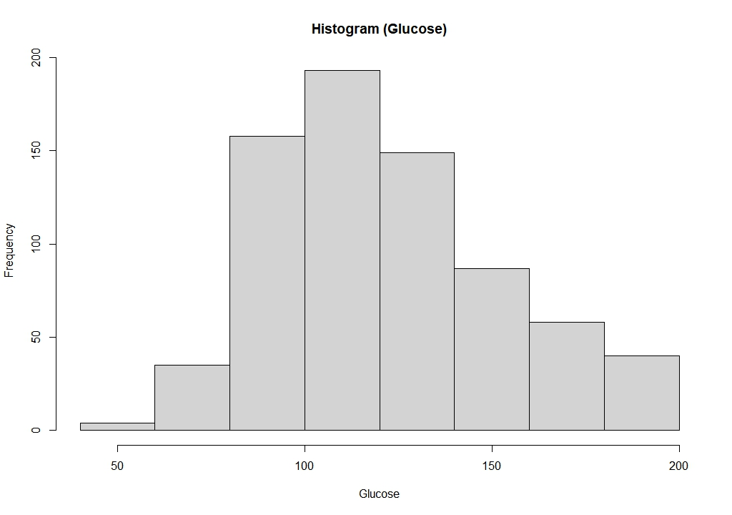
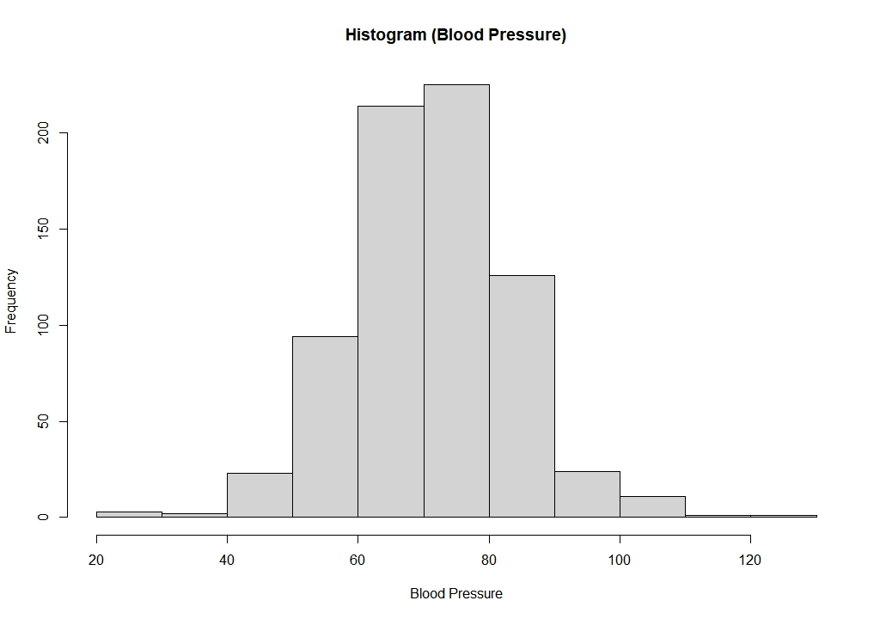
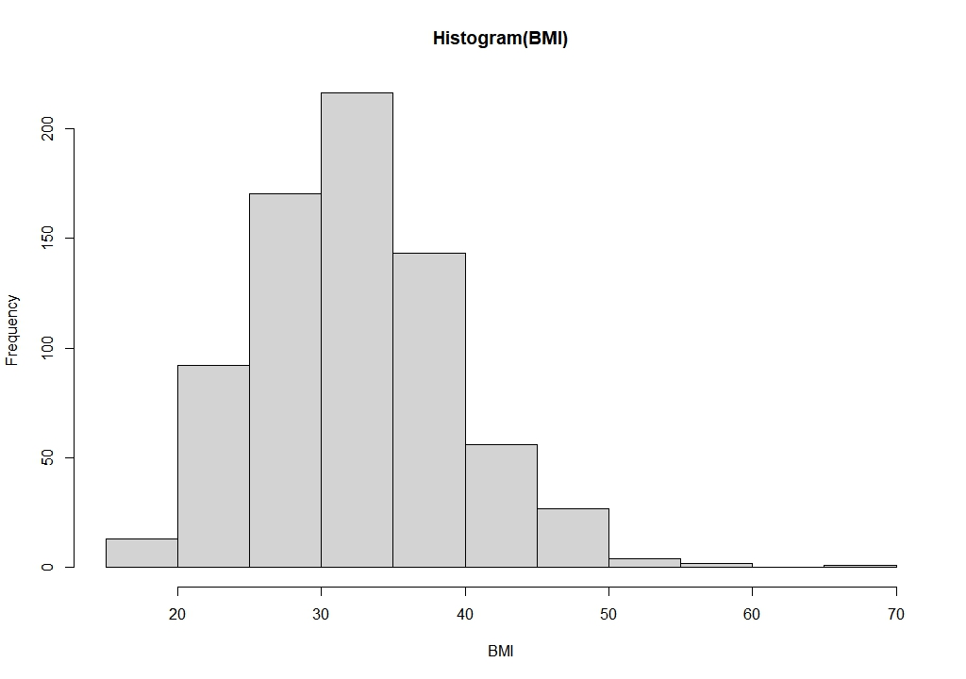
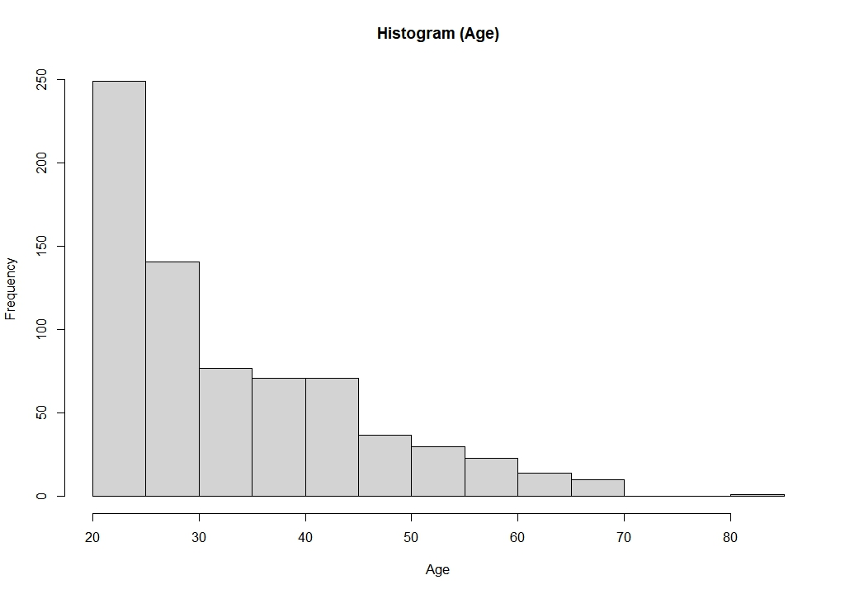
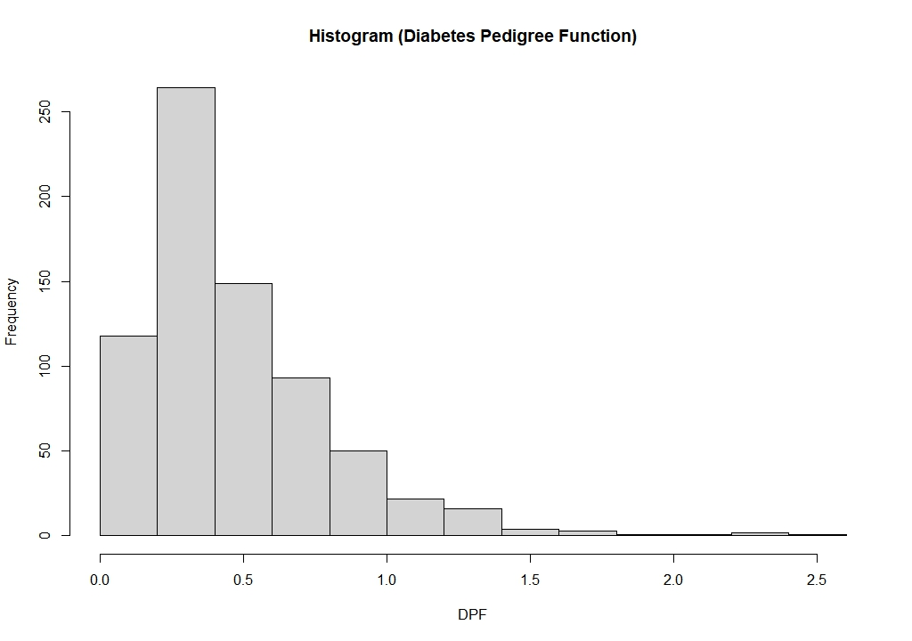
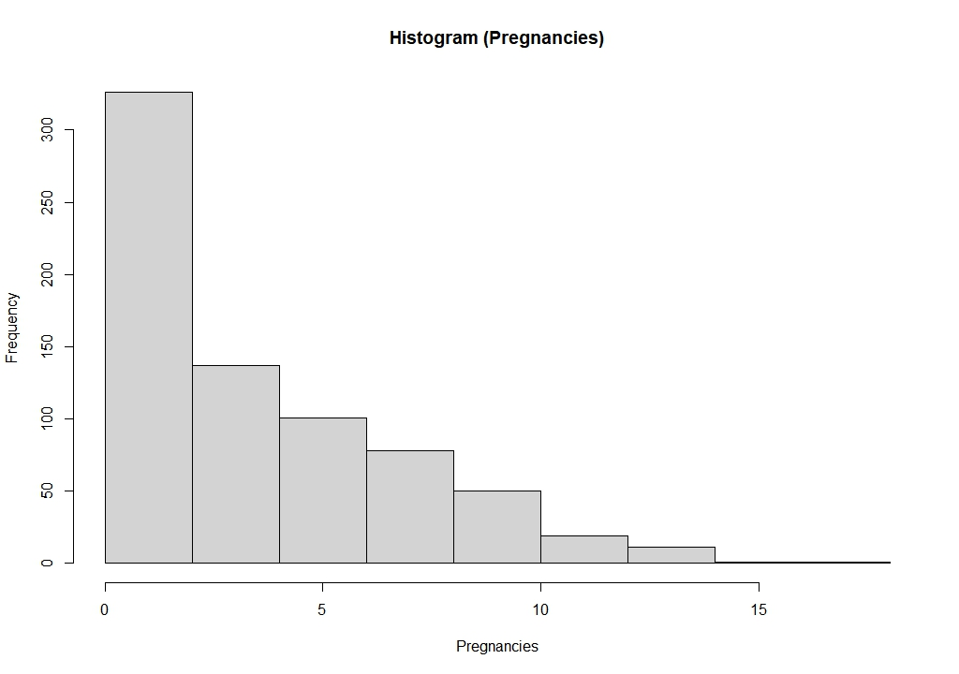
DISTRIBUTION ASSESSMENT
05
Glucose — broadly symmetric
Blood Pressure — approximately normal
BMI — moderate right skew
Age — strong right skew
DPF — heavy right skew
Pregnancies — count data, skewed

Slide 6
06
CORRELATION METHOD SELECTION
Three methods, justified by variable characteristics
Point-Biserial
Pearson
Spearman
When to use:
When to use:
When to use:
One binary variable (0/1)
Both continuous, approx. linear, no severe violations
Non-normal, count data, or monotonic relationship
Variable pairs:
Variable pairs:
Variable pairs:
Outcome ↔ Glucose
Glucose ↔ BMI
· Age ↔ Pregnancies
Outcome ↔ BMI
Age ↔ Blood Pressure
· Pregnancies ↔ BMI
Outcome ↔ Age
· Pregnancies ↔ Glucose
Outcome ↔ Blood Pressure
· DPF ↔ Glucose
· DPF ↔ BMI
Mathematically equivalent to Pearson when one variable is dichotomous
Scatterplots confirmed linear trends; mild heteroscedasticity noted for Age vs BP
Tied ranks present in Pregnancies — asymptotic p-values used

Slide 7
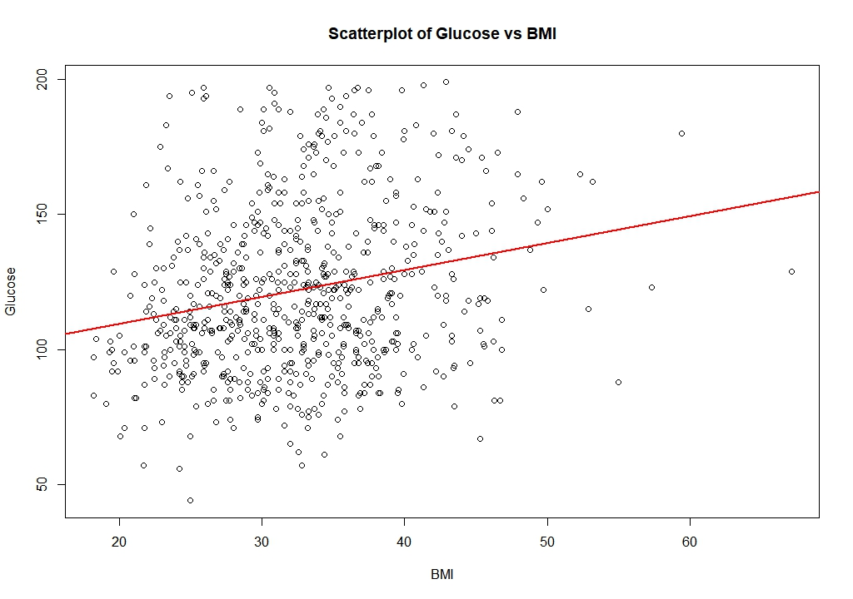
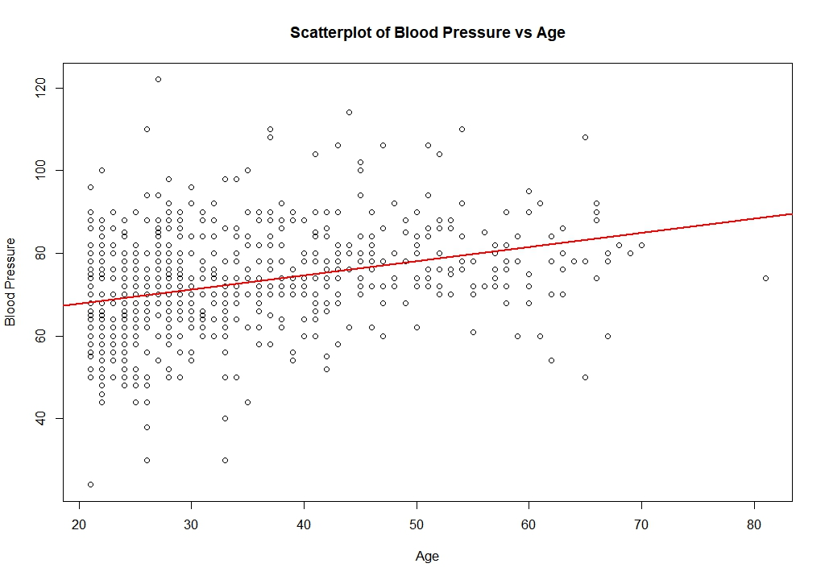
PEARSON ASSUMPTION CHECKS (SCATTERPLOTS)
07
Glucose vs BMI
Blood Pressure vs Age
r = 0.223
Approximately linear · Pearson appropriate
r = 0.325
Linear trend present · Mild heteroscedasticity noted

Slide 8
CORRELATION RESULTS — ALL 11 PAIRS
08
Variable Pair | Method | r / ρ | p-value
Outcome vs Glucose | Point-Biserial | 0.488 | < 0.001
Outcome vs BMI | Point-Biserial | 0.299 | < 0.001
Outcome vs Age | Point-Biserial | 0.246 | < 0.001
Outcome vs Blood Pressure | Point-Biserial | 0.167 | < 0.001
Glucose vs BMI | Pearson | 0.223 | < 0.001
Age vs Blood Pressure | Pearson | 0.325 | < 0.001
Age vs Pregnancies | Spearman | 0.617 | < 0.001
Pregnancies vs BMI | Spearman | −0.002 | 0.967
Pregnancies vs Glucose | Spearman | 0.138 | < 0.001
DPF vs Glucose | Spearman | 0.086 | 0.021 ⚠
DPF vs BMI | Spearman | 0.129 | < 0.001
⚠ DPF vs Glucose (p=0.021) is the weakest significant finding that interprets cautiously given no multiple-comparison correction was applied.

Slide 9
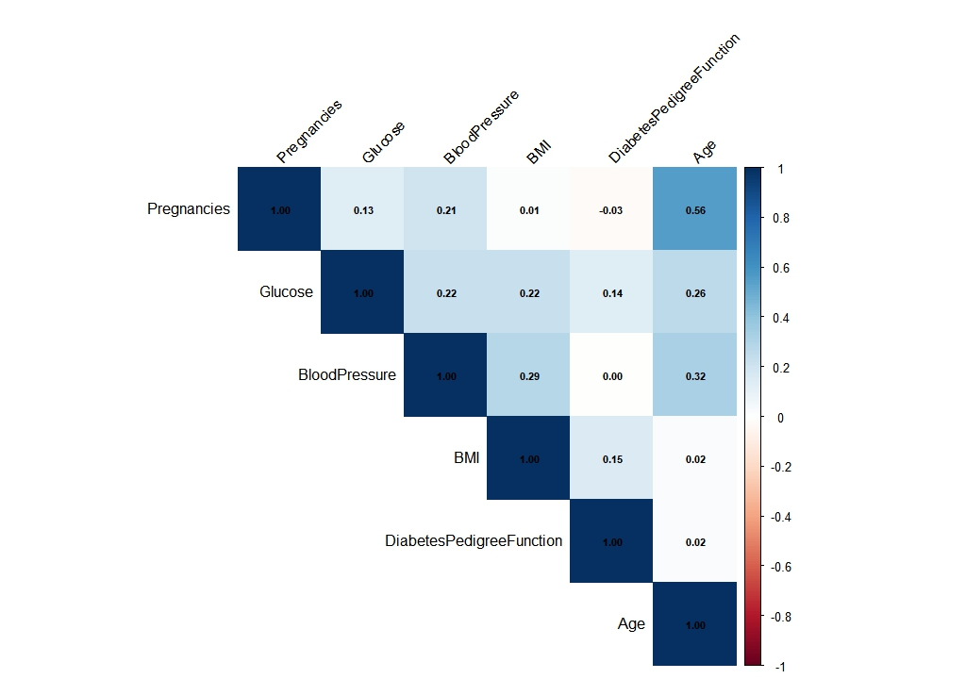
CORRELATION MATRIX (OVERALL PATTERN)
09
Key Observations
Age ↔ Pregnancies: strongest inter-variable association (0.56 Pearson / 0.617 Spearman)
Age ↔ Blood Pressure: moderate positive relationship (0.32)
Glucose ↔ BMI: weak positive link through metabolic pathway (0.22)
Pregnancies ↔ BMI: effectively zero — null result confirmed (0.01)
DPF shows only weak associations with other variables
Note: heatmap uses Pearson coefficients for all pairs as a visual overview. Method-specific results in the table are the primary analysis.

Slide 10
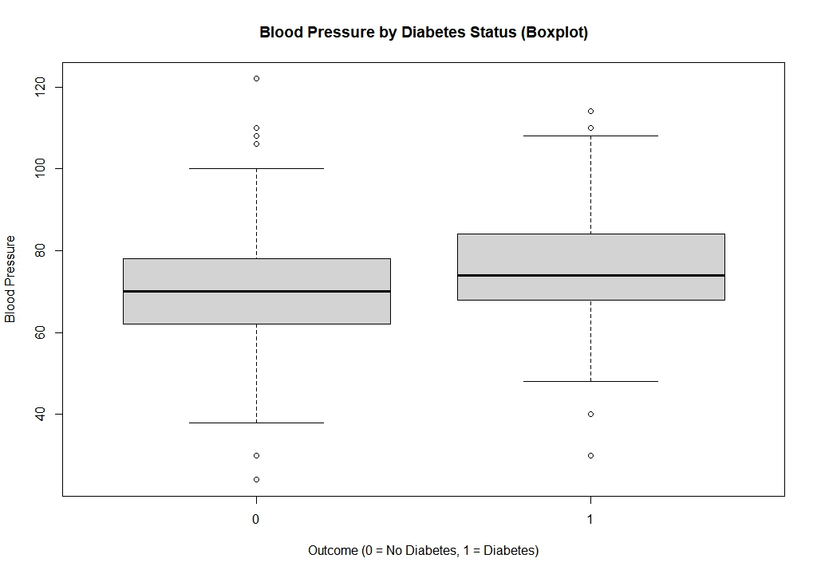
SUPPLEMENTARY ANALYSIS (BLOOD PRESSURE & DIABETES)
10
Why This Matters
70.9 mmHg
Non-Diabetic Mean BP
75.2 mmHg
Diabetic Mean BP
4.3 mmHg
Difference
p < 0.001
Welch t-test
Key insight: correlation (r = 0.167) understates the group-level difference. Statistical significance ≠ clinical significance — 4.3 mmHg is a marginal clinical difference.

Slide 11
11
KEY FINDINGS
What the correlations actually tell us
1
Glucose is the strongest clinical signal
2
Demographic variables are internally related but weakly predictive
r = 0.488 with diabetes status — the highest correlation in the study. Reflects the biological centrality of glucose dysregulation in Type 2 diabetes.
Age ↔ Pregnancies: ρ = 0.617. Yet both show weak associations with diabetes status — demographic variables capture shared structure, not diabetes risk.
3
Pregnancies vs BMI: a null result worth reporting
4
DPF associations are real but fragile
ρ = −0.002, p = 0.967. Despite theoretical expectations, parity and body composition were entirely unrelated in this dataset.
Familial risk shows weak positive links with Glucose and BMI. DPF vs Glucose (p = 0.021) may not survive multiple-comparison correction.

Slide 12
LIMITATIONS
12
L1
Cross-sectional data
L2
Missing data
Correlation does not imply causation. Directionality of relationships cannot be determined.
Listwise deletion reduced n from 768 to 724. Missingness may not be random, potentially introducing bias.
L3
Excluded variables
L4
Multiple comparisons
Insulin and SkinThickness were excluded due to excessive missingness. Important clinical information may be absent.
11 tests were run without Bonferroni or FDR correction. Weak findings (e.g. DPF vs Glucose, p=0.021) may be false positives.
L5
Heteroscedasticity
L6
Population specificity
Age vs Blood Pressure showed mild heteroscedasticity. Pearson coefficient should be interpreted with this caveat.
Results apply only to Pima Indian women. Generalization to other populations is not supported.

Slide 13
13
CONCLUSION
Clinical variables are more informative
than demographic characteristics
for diabetes status.
Association hierarchy with diabetes status:
r = 0.488
r = 0.299
r = 0.246
r = 0.167
Glucose
BMI
Age
Blood Pressure
Future work: logistic regression to examine independent contributions of multiple risk factors simultaneously.

Slide 14
REFERENCES
14
1. Field, A., Miles, J., & Field, Z. (2012). Discovering statistics using R. SAGE Publications.
2. Knowler, W. C., Bennett, P. H., Hamman, R. F., & Miller, M. (1978). Diabetes incidence and prevalence in Pima Indians: A 19-fold greater incidence than in Rochester, Minnesota. American Journal of Epidemiology, 108(6), 497–505. https://doi.org/10.1093/oxfordjournals.aje.a112648
3. R Core Team. (2025). R: A language and environment for statistical computing. R Foundation for Statistical Computing. Vienna, Austria. https://www.R-project.org/
4. UCI Machine Learning Repository. (n.d.). Pima Indians Diabetes Database. Retrieved June 22, 2026, from https://archive.ics.uci.edu/dataset/34/diabetes
5. World Health Organization. (2024, November 14). Diabetes. https://www.who.int/news-room/fact-sheets/detail/diabetes

